Slide 1
Images, Links and Lists in HTML

Slide 2
How to include image in HTML
<IMG>
IMG src attribute- This attribute defines the path to the specified image.
IMG alt attribute - This attribute fetches an alternate text for the given image
Image alt Attribute
The HTML alt attribute is used to provide an alternate text for the given image, if the website user cannot view the image due to delay in loading, slow internet connections or any other reason.
The content of the alt attribute should be precise and it should describe the purpose of the image.

Slide 3
Commonly used Images Format
Image File Format abbreviation | Full Form | File extension
APNG | APNG stands for Animated Portable Network Graphics | . apng
GIF | GIF stands for Graphics Interchange Format | .gif
ICO | ICO stands for Microsoft Icon | .ico .cur
PNG | The abbreviation PNG stands for Portable Network Graphics
SVG | The full form of SVG is Scalable Vector Graphics
JPEG | The full form of JPEG is Joint Photographic Expert Group image | .pjp .jpg .jpeg .pjpeg .jfif

Slide 4

Image on a HTML element
<img src=“ url…..”>

Slide 5
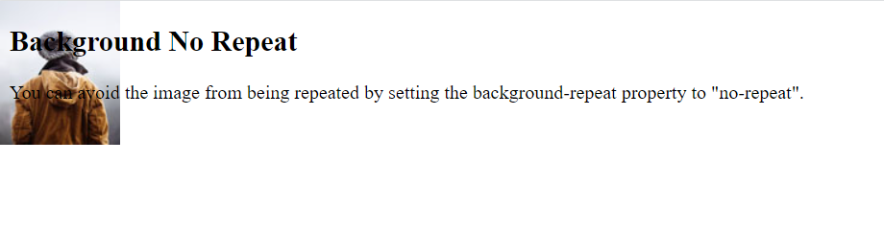
To avoid the background image from repeating itself, set the background-repeat property to no-repeat.
<style> body { background-image: url('example_img_girl.jpg'); background-repeat: no-repeat; } </style>

Slide 6

If you want the background image to cover the entire element, you can set the background-size property to cover.
Also, to make sure the entire element is always covered, set the background-attachment property to fixed:
This way, the background image will cover the entire element, with no stretching
<style> body { background-image: url('img_girl.jpg'); background-repeat: no-repeat; background-attachment: fixed; background-size: cover; } </style>

Slide 7

If you want the background image to stretch to fit the entire element, you can set the background-size property to 100% 100%:
<style> body { background-image: url('img_girl.jpg'); background-repeat: no-repeat; background-attachment: fixed; background-size: 100% 100%; } </style>

Slide 8
HTML Link
A webpage can contain various links that take you directly to other pages and even specific parts of a given page. These links are known as hyperlinks.
Hyperlinks allow visitors to navigate between Web sites by clicking on words, phrases, and images. Thus you can create hyperlinks using text or images available on a webpage.

Slide 9
HTML Links
A link is specified using HTML tag <a>.
This tag is called anchor tag and anything between the opening <a> tag and the closing </a> tag becomes part of the link and a user can click that part to reach to the linked document.
Syntax: <a href="url">link text</a>
The most important attribute of the <a> element is the href attribute,
which indicates the link's destination.
The link text is the part that will be visible to the reader.
Clicking on the link text, will send the reader to the specified URL address.

Slide 10
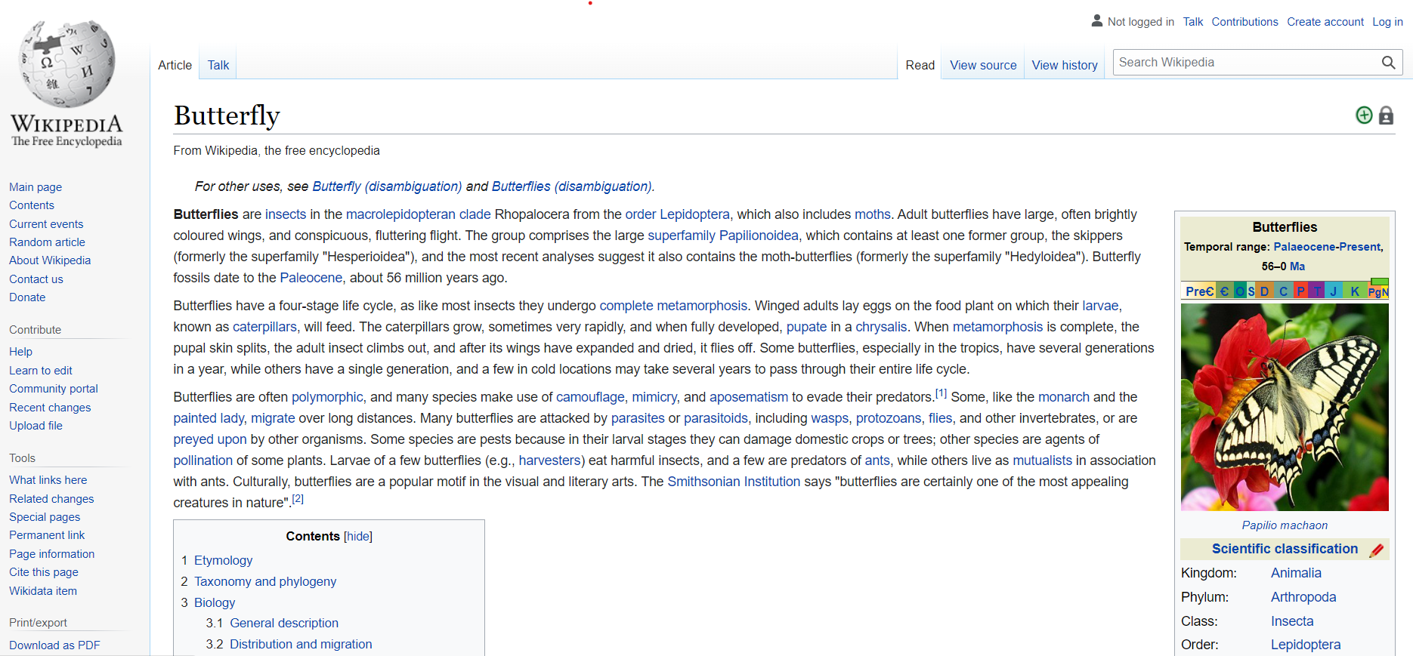
<!DOCTYPE html>
<html>
<body>
<h1>HTML Links</h1>
<p><a href="https://en.wikipedia.org/wiki/Butterfly">Butterfly!</a></p>
</body>
</html>

Slide 11
The target Attribute
This attribute is used to specify the location where linked document is opened.
Following are the possible options −
Sl.No | Option & Description
1 | _blank Opens the linked document in a new window or tab.
2 | _self Opens the linked document in the same frame.
3 | _parent Opens the linked document in the parent frame.
4 | _top Opens the linked document in the full body of the window.
5 | targetframe Opens the linked document in a named targetframe.

Slide 12
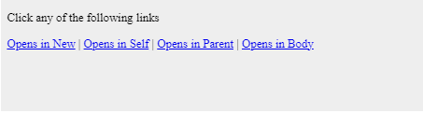
<!DOCTYPE html>
<html>
<head>
<title>Hyperlink Example</title>
<base href = "https://www.tutorialspoint.com/">
</head>
<body>
<p>Click any of the following links</p>
<a href = "/html/index.htm" target = "_blank">Opens in New</a> |
<a href = "/html/index.htm" target = "_self">Opens in Self</a> |
<a href = "/html/index.htm" target = "_parent">Opens in Parent</a> |
<a href = "/html/index.htm" target = "_top">Opens in Body</a>
</body>
</html>
When you link HTML documents related to the same website, it is not required to give a complete URL for every link. You can get rid of it if you use <base> tag in your HTML document header. This tag is used to give a base path for all the links. So your browser will concatenate given relative path to this base path and will make a complete URL.

Slide 13
Setting Link Colors
You can set colors of your links, active links and visited links using link, alink and vlink attributes of <body> tag.
<!DOCTYPE html>
<html>
<head>
<title>Hyperlink Example</title>
<base href = "https://www.tutorialspoint.com/">
</head>
<body alink = "#54A250" link = "#040404" vlink = "#F40633">
<p>Click following link</p>
<a href = "/html/index.htm" target = "_blank" >HTML Tutorial</a> </body> </html>
This will produce the following result. Just check color of the link before clicking on it, next check its color when you activate it and when the link has been visited.

Slide 14
HTML Lists
HTML lists allow web developers to group a set of related items in lists.
Example
An unordered HTML list:
Item
Item
Item
Item
An ordered HTML list:
First item
Second item
Third item
Fourth item

Slide 15
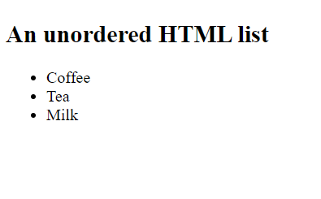
Unordered HTML List
An unordered list starts with the <ul> tag. Each list item starts with the <li> tag.
The list items will be marked with bullets (small black circles) by default:
<!DOCTYPE html>
<html>
<body>
<h2>An unordered HTML list</h2>
<ul>
<li>Coffee</li>
<li>Tea</li>
<li>Milk</li>
</ul>
</body>
</html>
You can use type attribute for <ul> tag to specify the type of bullet you like. By default, it is a disc. Following are the possible options −
<ul type = "square">
<ul type = "disc">
<ul type = "circle">

Slide 16
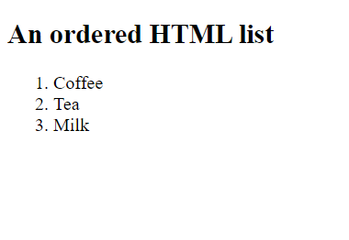
Ordered HTML List
An ordered list starts with the <ol> tag. Each list item starts with the <li> tag.
The list items will be marked with numbers by default:
<!DOCTYPE html>
<html>
<body>
<h2>An ordered HTML list</h2>
<ol>
<li>Coffee</li>
<li>Tea</li>
<li>Milk</li>
</ol>
</body>
</html>
You can use type attribute for <ol> tag to specify the type of numbering you like. By default, it is a number. Following are the possible options −
<ol type = "1"> - Default-Case Numerals.
<ol type = "I"> - Upper-Case Numerals.
<ol type = "i"> - Lower-Case Numerals.
<ol type = "A"> - Upper-Case Letters.
<ol type = "a"> - Lower-Case Letters.
The start Attribute
You can use start attribute for <ol> tag to specify the starting point of numbering you need. Following are the possible options −
<ol type = "1" start = "4"> - Numerals starts with 4.

Slide 17
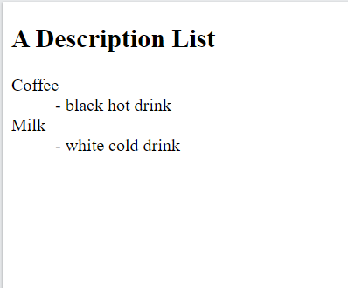
HTML Description/Definition Lists
HTML also supports description lists.
A description list is a list of terms, with a description of each term.
The <dl> tag defines the description list, the <dt> tag defines the term (name), and the <dd> tag describes each term:
<!DOCTYPE html>
<html>
<body>
<h2>A Description List</h2>
<dl>
<dt>Coffee</dt>
<dd>- black hot drink</dd>
<dt>Milk</dt>
<dd>- white cold drink</dd>
</dl>
</body>
</html>

